Slide 1
<INSTRUCTOR’S
COPILOT>
FINAL PRESENTATION
Nabih Sabeh, Tracy Chin, Matthew Thomas, Andi Rodriguez

Slide 2
01
02
03
<CODE>
<EVOLUTION>
<PROBLEM & SOLUTION>
/Describe the Problem solved.
/Describe the code and UI created.
/Describe Minimum Variable Product & POC.

Slide 3
<PROBLEM & SOLUTION>
01
Describe the Problem Solved

Slide 4
/PROBLEM

Slide 5
/SOLUTION
Designed for Full-Time and Part-Time Professors who lack time and resources to prepare before class.
Notes:
This product will allow the user to upload PDFs andl provide new real-life ideas to help the teacher make explanations better. Break down the response by subject, and for each subject, include a use case, a real-life example, and discussion ideas

Slide 6
<CODE>
02
Describe Code and UI Created

Slide 7

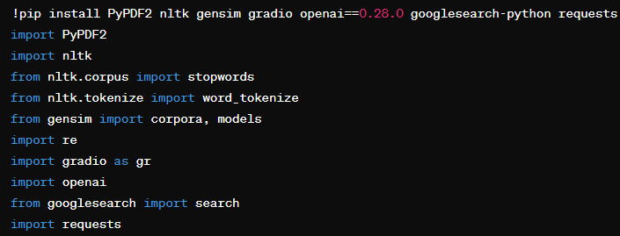
EXPLAINED
Install libraries: PyPDF2, nltk, gensim, gradio, openai, googlesearch-python, requests.
Import libraries into the script.
Use libraries for text processing, topic models, web interface, GPT-4, and link checks.
Notes:
First, we install the required libraries using pip. Here's what we installed and why:
PyPDF2: To read and extract text from PDF files.
nltk: For natural language processing, specifically for tokenization and stopwords.
gensim: To create topic models from the text.
gradio: To create an interactive web interface for our application.
openai: To interact with the OpenAI API for querying GPT-4.
googlesearch-python: To search for trending links related to our topics.
requests: To handle HTTP requests, useful for checking the availability of links After installing, we import these libraries into our script."

Slide 8
EXPLAINED
Download nltk data: 'punkt' (tokenizing sentences) and 'stopwords' (common words to exclude).
Use 'punkt' for word tokenization and 'stopwords' for filtering out common words.
Notes:
We need to download additional data for the nltk library:
'punkt': Used for tokenizing sentences into words.
'stopwords': Provides a list of common words (like 'the', 'and', 'is') that we want to exclude from our analysis."

Slide 9
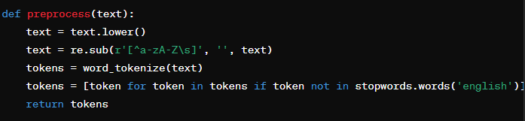
EXPLAINED
Lowercase text for uniformity.
Remove non-alphabetic characters with regex.
Tokenize text into words and remove stopwords.
Notes:
This function handles the preprocessing of text. Here’s what each step does:
Lowercasing: Converts all characters to lowercase to ensure uniformity.
Remove non-alphabetic characters: Uses regular expressions to remove numbers and punctuation.
Tokenization: Splits the text into individual words.
Remove stopwords: Filters out common words that do not carry significant meaning."

Slide 10
EXPLAINED
Input OpenAI API key to authenticate GPT-4 access.
Notes:
Next, we input our OpenAI API key. This key is necessary to authenticate our requests to OpenAI's services, specifically to access the GPT-4 model."

Slide 11
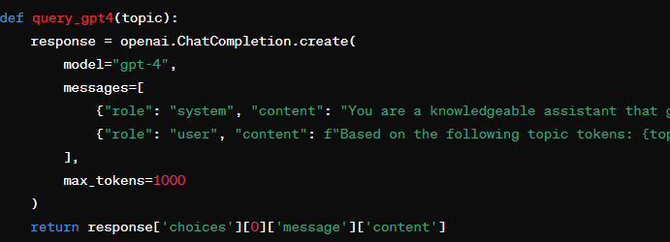
EXPLAINED
Define query for GPT-4: Generate new teaching ideas from topic tokens.
Specify response format: Include use cases, real-life examples, discussion ideas, and related links.
Make API call: Send request to OpenAI and retrieve response.
Notes:
How the code works, step by step: "This function sends a query to GPT-4.
Define the query: We ask GPT-4 to generate new teaching ideas based on given topic tokens.
Response format: We specify the response format to include use cases, real-life examples, discussion ideas, and related links.
Purpose of the API key to GPT: The function sends the request to OpenAI and retrieves the response."
Prompt:And I gave it this prompt to provide structured teaching ideas based on given topics, including use cases, real-life examples, and discussion ideas for each subject→ "You are a knowledgeable assistant that give an AI teacher a new ideas for teaching."},
Way it works: Based on the following topic tokens: {topic}, product will provide new real-life ideas to help the teacher make explanations better. Break down the response by subject, and for each subject, include a use case, a real-life example, and discussion ideas. Format the response using the following structure

Slide 12
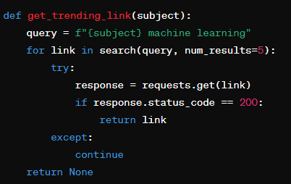
EXPLAINED
Define search query: Subject + 'machine learning'.
Google search: Find relevant links using googlesearch-python.
Check availability: Verify link with requests; return first accessible link.
Notes:
We used this function: search for trending links related to each subject.
Steps:
Define the search query: Combines the subject with 'machine learning'.
Google search: Uses the googlesearch-python library to find relevant links.
Check link availability: Uses the requests library to ensure the link is accessible.
Return the link: Returns the first available link."

Slide 13
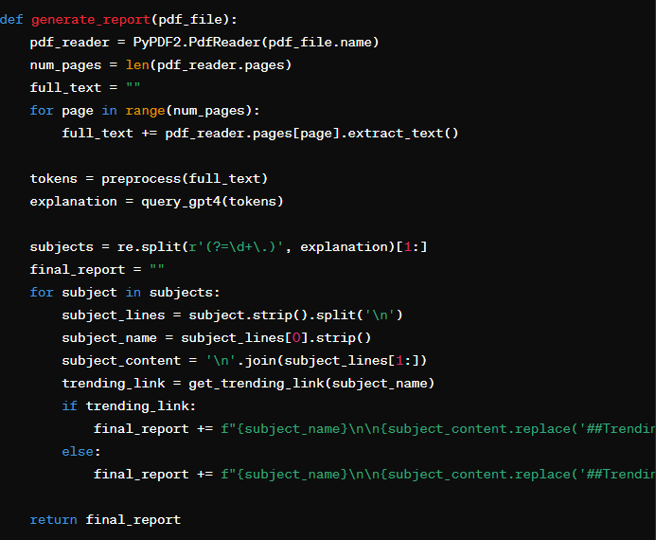
EXPLAINED
Extract text: Use PyPDF2 to read the PDF.
Preprocess text: Clean and tokenize using the preprocess function.
Generate report: Query GPT-4 for teaching ideas, find relevant links, and compile the final report.
Notes:
This function generates a teaching report from a PDF file. Here's a detailed breakdown:
Read the PDF: Uses PyPDF2 to extract text from each page.
Preprocess the text: Calls the preprocess function to clean and tokenize the text.
Query GPT-4: Sends the tokens to GPT-4 to generate teaching ideas.
Parse the response: Splits the response into individual subjects.
Get trending links: Searches for relevant links for each subject.
Compile the report: Combines the teaching ideas and links into a final report."

Slide 14
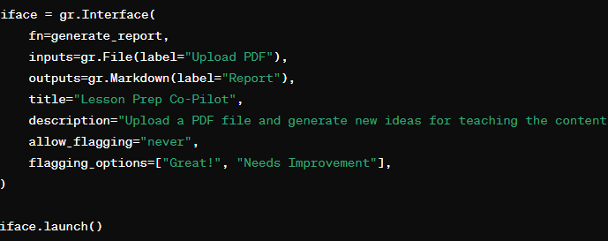
EXPLAINED
Define interface: Set function, input/output types, and settings.
Launch app: Start Gradio for PDF upload and teaching report generation.
Notes:
Finally, we set up a Gradio interface to make our application user-friendly. Here's what each part does:
Define the interface: Specifies the function to run, input and output types, and additional settings.
Launch the interface: Starts the Gradio app, allowing users to upload a PDF and receive a teaching report."

Slide 15
/DEMO
Demo Video

Slide 16
<EVOLUTION>
03
Describe Minimum Variable Product & POC.

Slide 17
EVOLUTION
INSTRUCTORS
STUDENTS
FINANCE
PARENTS
From school teachers to college professors.
Modify the code so students can use this as a tool for studying and retention.
Modify the code for C-Suite Executives reviewing investor decks.
Parents who homeschool their children.
Notes:
This is our MVP product.
Product can be repurposed for other personas such as students for similar purposes
This product can be a resource for instructors to interact and communicate. And more.
For future plans we will use Agile methodology to get feedback iterate and improve.

Slide 18
<Thank You>
Open for Questions

